Slide 1
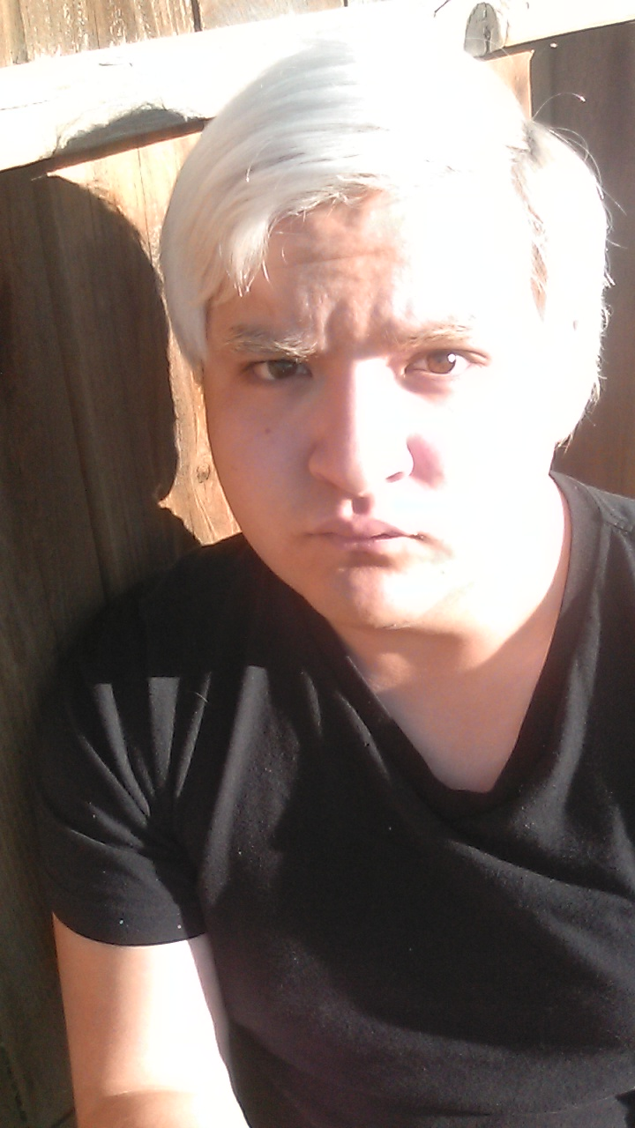
Pedro Nava-Cervantes.

Slide 2
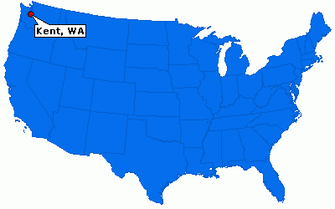
Birth.
My name is Pedro Nava-Cervantes. I was born on July-7th-1998.
I was born in Kent, Washington State. In the United States of America. At 7:27 P.M. In room 7.

Slide 3
School.
I attended kindergarten at Cedar Valley Cheetahs, in Covington, which is a city in Washington state.

Slide 4
Years in Washington.
I lived in Washington State for 9 years. And during the summer of 2007, it would be my last year living in Washington State.

Slide 5
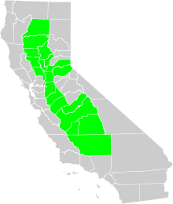
Where I moved after Washington.
After leaving Washington State I moved to Tulare, California. I did not like Tulare, California, I lived in Tulare, California for 5 years. And I did not like California, and I still do not like living in California.

Slide 6
Middle school in Tulare, California.
After attending two elementary schools, for sixth grade I moved on to middle school. And I attended Mulcahy Middle school for one year. It was pretty weird there. My sixth grade teacher was from London, England, his name is Mr. Bradford and he would always say “In the future”, a lot.

Slide 7
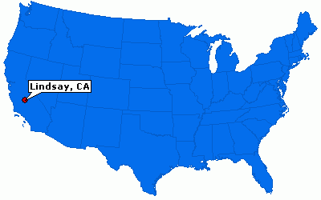
Where I moved after Tulare, California.
After living in Tulare, California me and my Parents moved to Lindsay, California. I like Lindsay California much better than I do Tulare, California. I still don’t like California though.

Slide 8
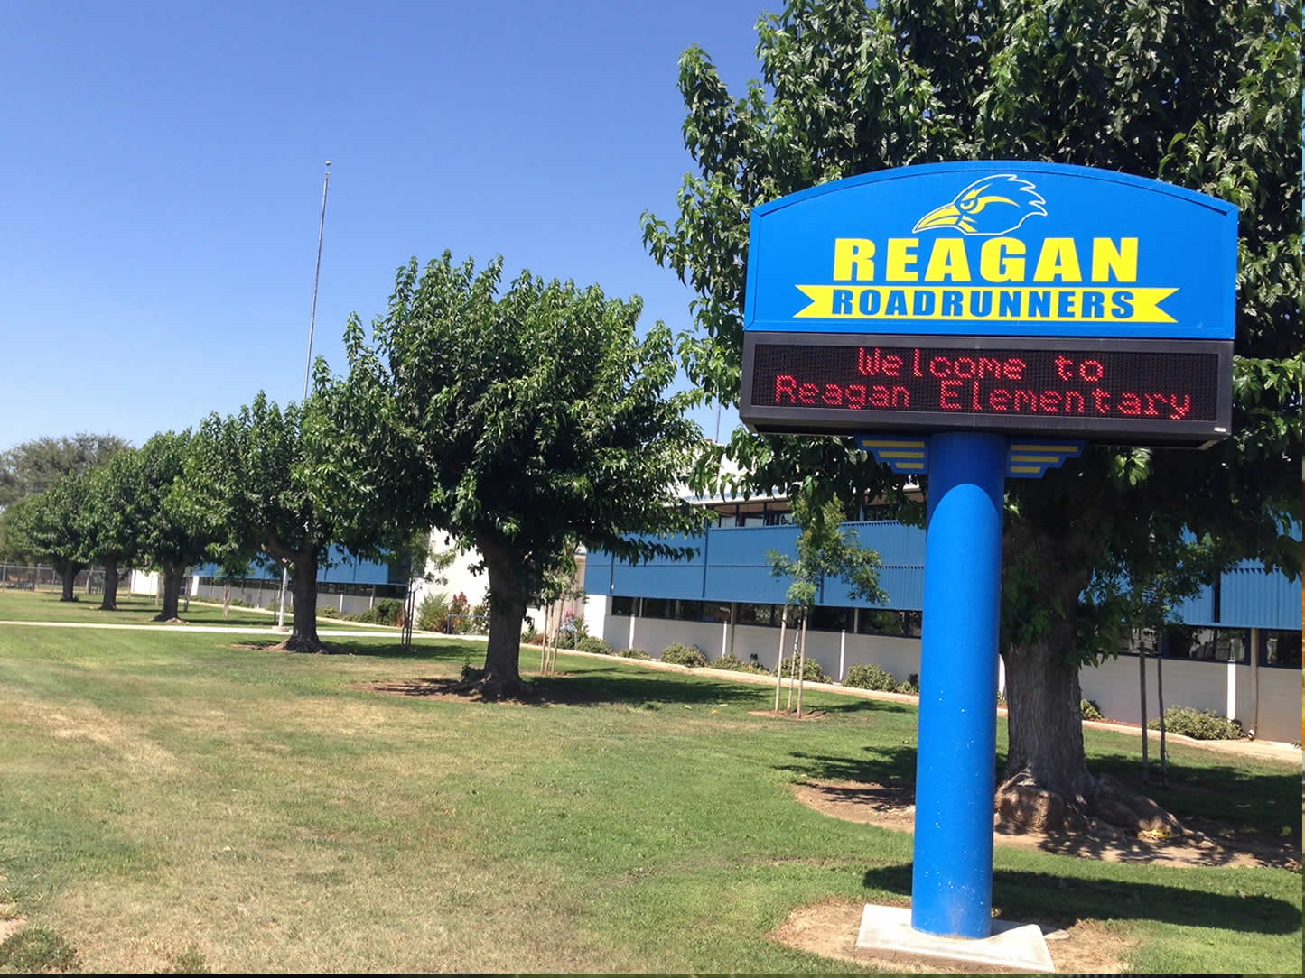
Where I attended elementary school.
I attended elementary school at Reagan Elementary, I was there for 2 years, from 7th grade to 8th grade.

Slide 9
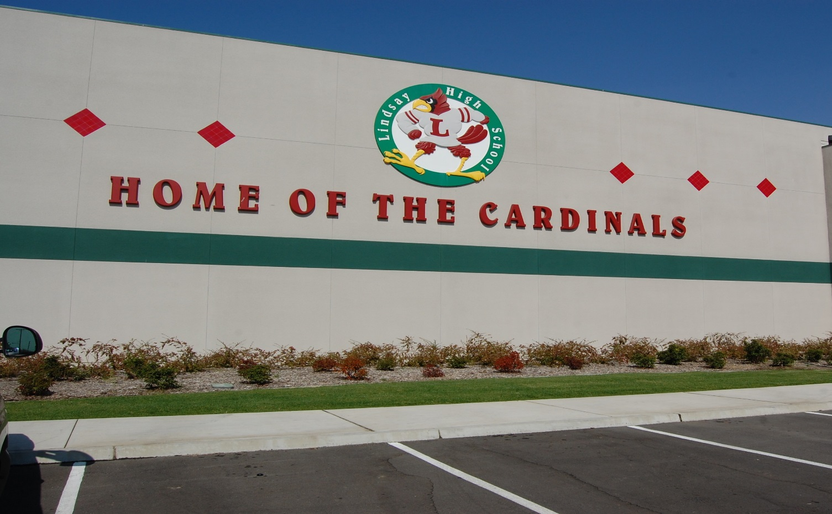
Where I attended school after Reagan Elementary.
After leaving Reagan Elementary school, I went on to 9th grade at Lindsay High School, I have attended Lindsay High School for 4 years.
The P.B.S. System. Because it allows me to work at my own pace. Weather I need to spend more time on a cetin topic or if I can complete a class early ahead of time.

Slide 10
One huge difference between Tulare, California and Lindsay California.
One huge difference from Lindsay and Tulare, California is that the people in Lindsay are much more nice than the people in Tulare, California. That was a huge shock to me because I was always used to people being mean to me.
Tulare, California.
Lindsay, California.

Slide 11
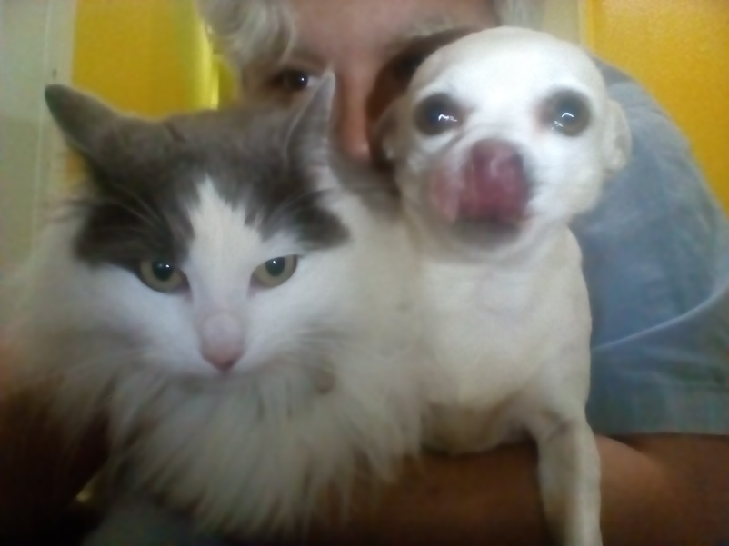
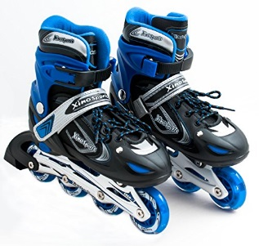
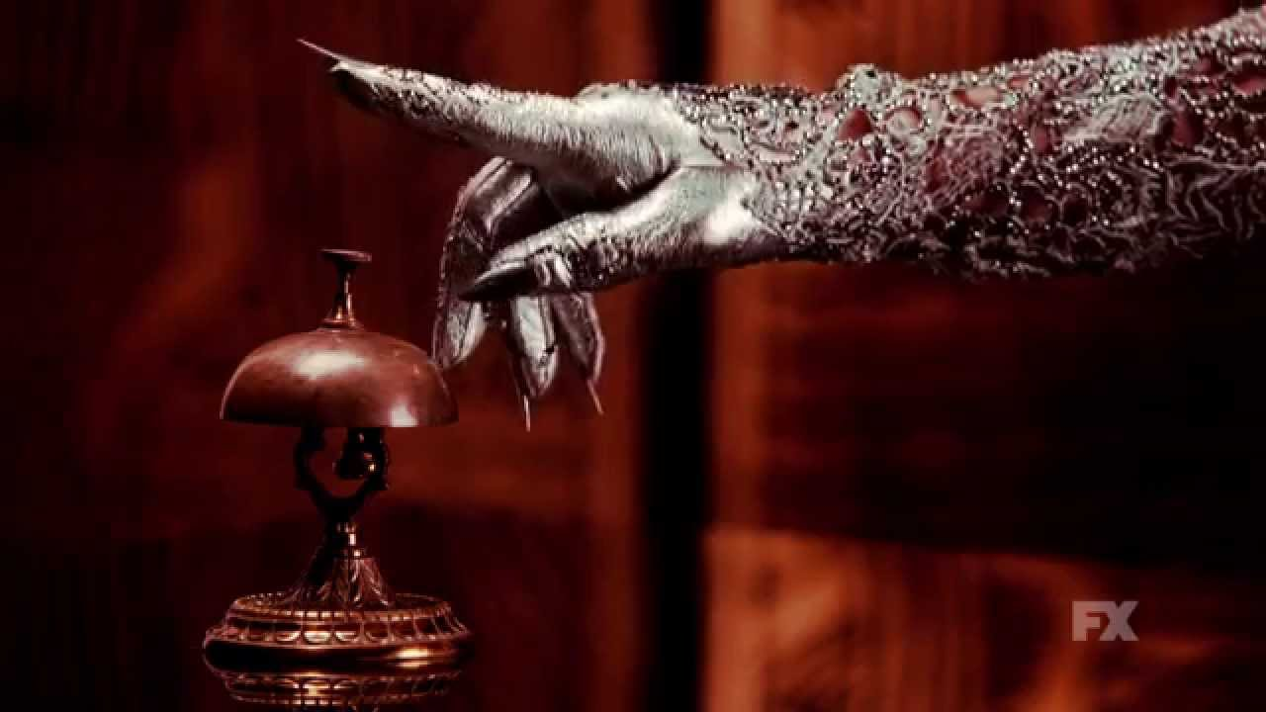
Things that I like.
I like animals, rollerblading, watching movies, listening to music, playing with my Apple-Head Chihuahua Chloë and my Cat Mocha de Lucia Nava and watch T.V. Shows such as American Horror Story, The Mick, and Friends.

Slide 12
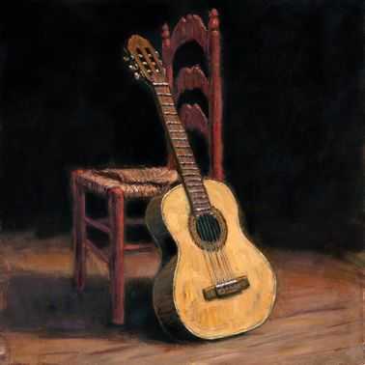
My hobbies.
During my Spare time I like to play my guitar, sing, Knit, and sew.

Slide 13
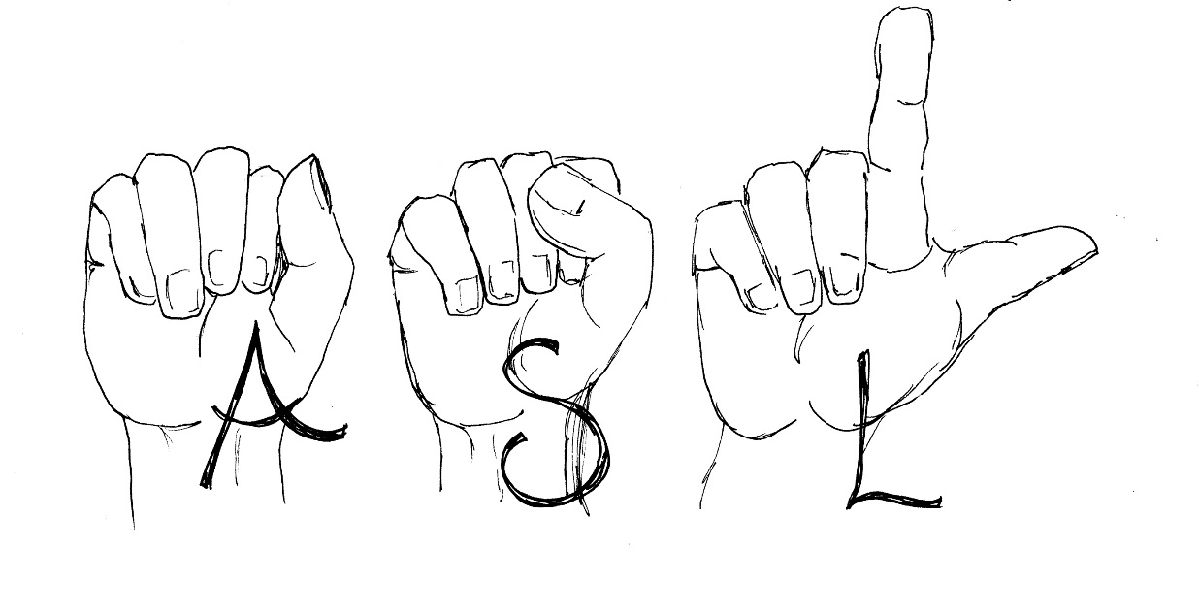
What have I done in LHS?
I have been an active member of the A.S.L. Club for 4 years now, and I have participated in many fundraisers for the club, and this year I am currently the vise president of the A.S.L. Club. One exciting thing that I got to do by being in the A.S.L. Club is me and the rest of the club members got to go to Six Flags on Deaf Day, there were a lot of deaf people, there were thousands of deaf people there. I went on a rollercoaster filled with deaf people and none of them screamed.

Slide 14
My Job Shadow.
For my Job Shadow I Job Shadowed an A.S.L. Interpreter named Mr. Mashtal for about 7 and a half hours. It was very fun, I learned about confidentiality with clients, and I even saw how mentally exhausting it could be to interpret A.S.L. To English. The reason why I Job Shadowed an A.S.L. Interpreter is, A.S.L. Is really fun to learn, and I wanted to see what an A.S.L. Interpreter did all day. I also might want to be an A.S.L. Interpreter myself.

Slide 15
What I plan to do after I leave L.H.S.
After I leave L.H.S. I am going to go to C.O.S. In the fall, in-fact I am currently enrolled into C.O.S. Right now. I plan on being there for two years and then transferring to a 4-year university to get a bachelors degree in acting, I think I would like to go to U.C.L.A. I want to be an actor, if I cannot be an actor, than I would like to be an A.S.L. Interpreter.

Slide 16
Thank you.

